Slide 1

Volume & Thermal Solver
Accelerated Time-to-Market & Right-First-Time Design

Slide 2


Executive Summary
•
Unified Solution: Combines complex geometric cabinet volume calculations with deep thermodynamic performance analysis into a single engine.
•
Accelerated Timeline: Reduces multi-day design iteration cycles between mechanical and thermal engineering teams to minutes.
•
Optimized Cost: Enables instant parametric sweeping to balance polyurethane insulation costs against targeted energy rankings early in the design phase.
•
Rigorous Validation: Core algorithms fully benchmarked against existing production models.

Slide 3


The Capability Gap
The Status Quo
The Bottleneck
Currently, mechanical design (cabinet volume, insulation thickness) and system engineering (thermal loads, compressor matching) operate in silos. Calculating net volume, PU weight, and mapping that to compressor performance requires fragmented, manual effort.
When engineering changes a single parameter—such as the compressor step geometry or door dike depth—evaluating the cascading impact on thermal load and total energy consumption is time-consuming, delaying critical upfront design decisions.

Slide 4





Institutional Validation
Architecture
Geometry
Thermal Dynamics
The foundational logic and baseline formulas were originated by Eng. Elhady, ensuring the solver executes proven methodologies instantly.
Eng. Hani verified the volume calculation logic, including complex cross-sectional areas for stepped floors, door dikes, and evaporator intrusions.
Eng. Abdelhameed benchmarked the thermodynamic solver, verifying calculated heat loads, LMTD, and required RPMs for modern inverter components.

Slide 5

Geometric Validation
Metric | Official CAD Spec (SJ54H) | Solver Engine Output | Variance (%)
Gross Volume (L) | 431.2 | 430.8 | < 0.1%
Net Volume (L) | 398.5 | 399.1 | 0.15%
Cabinet PU Weight (kg) | 7.82 | 7.84 | 0.25%
Door PU Weight (kg) | 2.41 | 2.42 | 0.4%
All geometric variances fall well within strict engineering tolerances (< 0.5%).

Slide 6
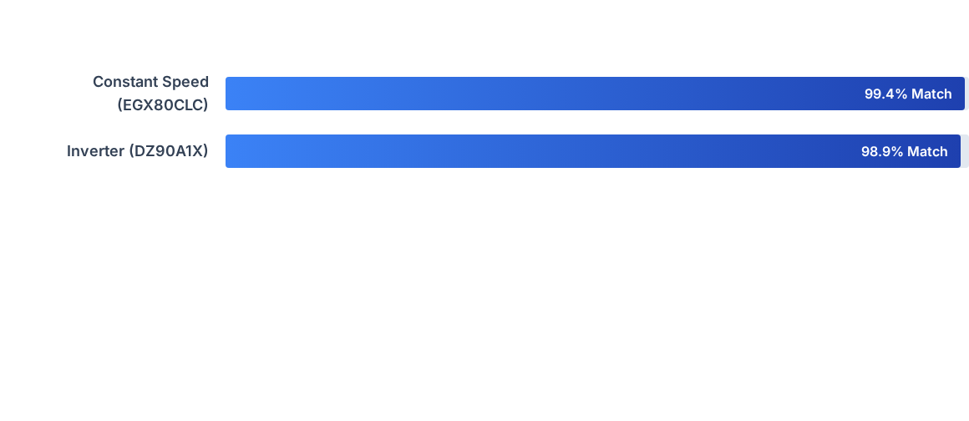
Thermal Accuracy
Because the thermal engine relies on exact geometric inputs directly from the volume module, we eliminate data-transfer errors between mechanical and thermal analysis workflows.

Slide 7







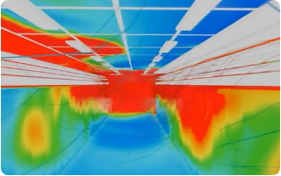
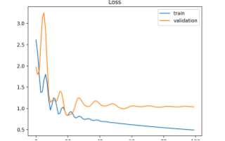
Workflow Demonstration
1. Load Baseline
2. Run Thermal
3. Parametric Sweep
Instantly compute precise volumes and polyurethane weights from unified cabinet geometry parameters.
Solve dynamic operating points, calculate heat loads, and determine the exact Energy Ranking.
Sweep variables (e.g., adding 10mm insulation) to instantly graph the impact on usable volume vs. energy cost.

Slide 8
Sustainability & Security
Decoupled Architecture: Built on standard, secure web technologies (HTML/JS/CSS). The calculation logic is fully decoupled from the UI, well-documented, and requires no proprietary server licenses.
Upfront Optimization: This does not replace our final CAD or physical thermal testing protocols. It simply ensures the prototype we invest in building is mathematically the right one, shifting optimization left.
Dynamic Compressor Ingestion: We are not locked into hardcoded components. The tool features a custom ingestion engine to upload CSV data from any supplier, automatically fitting mathematical curves via regression.

Slide 9
Next Steps
Our proposed next step is a beta-rollout to the design team for the upcoming model, running the solver in parallel with current methods to definitively prove time savings.
Any specific areas of the calculation engine you'd like us to detail further?

Slide 10




Image Sources
https://cdn.prod.website-files.com/67af3db5bb3b892e61258bd4/6a0ce3d165569c8f89efd669_337-guide-to-dashboard-reporting.png
Source: www.domo.com
https://www.ucf.edu/wp-content/blogs.dir/16/files/2018/05/ms-da-Highlights-e1777063449665.jpg
Source: www.ucf.edu
https://intransition.openlibhums.org/article/id/16462/file/214758/
Source: intransition.openlibhums.org
https://machinelearningmastery.com/wp-content/uploads/2018/12/Example-of-Train-and-Validation-Learning-Curves-Showing-a-Training-Dataset-the-May-be-too-Small-Relative-to-the-Validation-Dataset.png
Source: machinelearningmastery.com

